Slide 1

Ethics in Information Technology
Chapter 2
Ethics for IT Workers and IT Users

Slide 2
Objectives
As you read this chapter, consider the following questions:
  What key characteristics distinguish a professional from other kinds of workers, and is an IT worker considered a professional?
  What factors are transforming the professional services industry?
  What relationships must an IT worker manage, and what key ethical issues can arise in each?
Ethics in Information Technology, Third Edition

Slide 3
Objectives (cont’d.)
  How do codes of ethics, professional organizations, certification, and licensing affect the ethical behavior of IT professionals?
  What are the key beliefs of five different codes of ethics that provide guidance for IT professionals?
Ethics in Information Technology, Third Edition

Slide 4
IT Professionals
Profession is a calling that requires:
  Specialized knowledge
  Long and intensive academic preparation
Professionals:
  Require advanced training and experience
  Must exercise discretion (preference) and judgment in their work
  One’s work is predominantly intellectual and varied in character, and the output or result cannot be standardized in relation to a given period of time
  Carry special rights and responsibilities
Ethics in Information Technology, Third Edition

Slide 5
Are IT Workers Professionals?
Partial list of IT specialists
  Programmers
  Systems analysts
  Software engineers
  Database administrators
  Local area network (LAN) administrators
  Chief information officers (CIOs)
  Project Managers
  IS Security Specialist
Ethics in Information Technology, Third Edition

Slide 6
Are IT Workers Professionals?
(cont’d.)
Legal perspective
  IT workers are not recognized as professionals
  Not licensed by state or federal government
  IT workers are not liable for malpractice
Ethics in Information Technology, Third Edition

Slide 7
The Changing Professional Services Industry
Although not legally classified as professionals,
IT workers are considered part of the professional services industry
Seven forces are changing professional services
  Client sophistication (able to drive hard bargains)
  Governance (due to major scandals)
  Connectivity (instant communications)
  Transparency (real-time work in progress)
  Modularization (able to outsource modules)
  Globalization (industry extremely competitive)
  Commoditization (for low-end services)
Ethics in Information Technology, Third Edition

Slide 8
Professional Relationships That Must Be Managed
IT workers have many different relationships with:
  Employers
  Clients
  Suppliers
  Other professionals
  IT users
  Society at large
Ethics in Information Technology, Third Edition

Slide 9
Relationships Between
IT Workers and Employers
IT workers must set an example and enforce policies regarding the ethical use of IT in:
  Software piracy
    Act of illegally making copies of software or enabling access to software to which they are not entitled
    Area in which IT workers can be tempted to violate laws and policies
    The Business Software Alliance (BSA) is a trade group representing the world’s largest software and hardware manufacturers; mission is to stop the unauthorized copying of software
Ethics in Information Technology, Third Edition

Slide 10
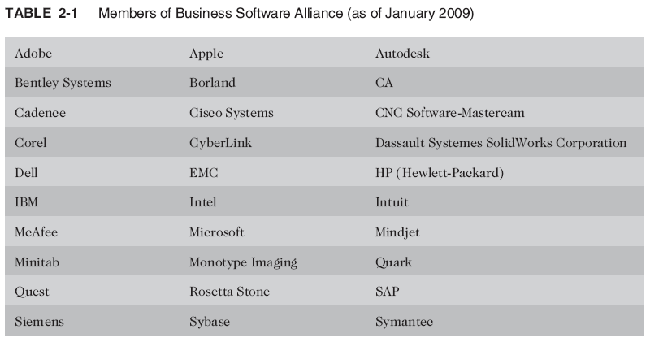
Relationships Between
IT Workers and Employers (cont’d.)
Ethics in Information Technology, Third Edition

Slide 11
Relationships Between
IT Workers and Employers (cont’d.)
IT workers must set an example and enforce policies regarding the ethical use of IT in: (cont’d)
  Trade secrets
    Business information generally unknown to public
    Company takes actions to keep confidential
    Require cost or effort to develop
    Have some degree of uniqueness or novelty
  Whistle-blowing
    Employee attracts attention to a negligent, illegal, unethical, abusive, or dangerous act that threatens the public interest
Ethics in Information Technology, Third Edition

Slide 12
Relationships Between
IT Workers and Clients
IT worker provides:
  Hardware, software, or services at a certain cost and within a given time frame
Client provides:
  Compensation
  Access to key contacts
  Work space
Relationship is usually documented in contractual terms
Ethics in Information Technology, Third Edition

Slide 13
Relationships Between
IT Workers and Clients (cont’d.)
Ethical problems arise if a company recommends its own products and services to remedy problems they have detected
  A company is unable to provide full and accurate reporting of a project’s status
Ethics in Information Technology, Third Edition

Slide 14
Relationships Between
IT Workers and Clients (cont’d.)
Fraud
  Crime of obtaining goods, services, or property through deception or trickery
  Fraud is proven in court
Misrepresentation
  Misstatement or incomplete statement of material fact
  Problem if causes entry into contract
Breach of contract
  One party fails to meet the terms of a contract
Ethics in Information Technology, Third Edition

Slide 15
Relationships Between
IT Workers and Clients (cont’d.)
IT projects are joint efforts in which vendors and customers work together
  Difficult to assign blame
Ethics in Information Technology, Third Edition

Slide 16
Relationships Between
IT Workers and Suppliers
Develop good working relationships with suppliers:
  To encourage flow of useful information and ideas
  By dealing fairly with them
  By not making unreasonable demands
Bribery (Corruption)
  Providing money, property, or favors to obtain a business advantage
  U.S. Foreign Corrupt Practices Act (FCPA): crime to bribe a foreign official, a foreign political party official, or a candidate for foreign political office
Ethics in Information Technology, Third Edition

Slide 17
Relationships Between
IT Workers and Suppliers (cont’d.)
Bribery (cont’d.)
  At what point does a gift become a bribe?
  No gift should be hidden
  Perceptions of donor and recipient can differ
Ethics in Information Technology, Third Edition

Slide 18
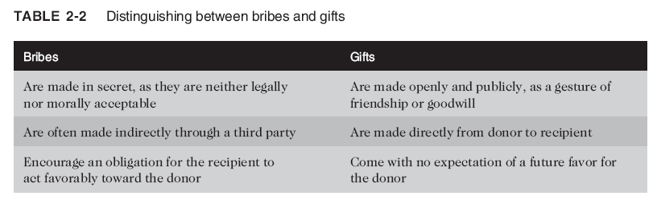
Relationships Between
IT Workers and Suppliers (cont’d.)
Ethics in Information Technology, Third Edition

Slide 19
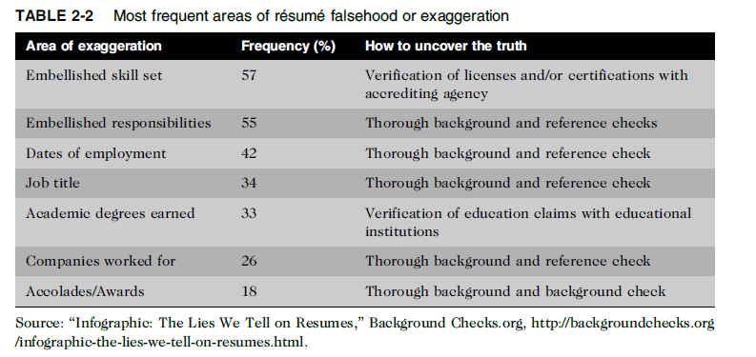
Relationships Between
IT Workers and Other Professionals
Professionals owe each other adherence to a profession’s code of conduct
Ethical problems among the IT profession
  Résumé inflation
  Inappropriate sharing of corporate information
Ethics in Information Technology, Third Edition

Slide 20
Relationships Between
IT Workers and IT Users
IT user: person using a hardware or software product
IT workers’ duties
  Understand users’ needs and capabilities
  Deliver products and services that meet those needs
  Establish environment that supports ethical behavior:
    To discourages software piracy
    To minimize inappropriate use of corporate computing resources
    To avoid inappropriate sharing of information
Ethics in Information Technology, Third Edition

Slide 21
Relationships Between
IT Workers and Society
Society expects members of a profession:
  To provide significant benefits
  To not cause harm through their actions
Actions of an IT worker can affect society
Professional organizations provide codes of ethics to guide IT workers’ actions
Ethics in Information Technology, Third Edition

Slide 22
Professional Codes of Ethics
State the principles and core values that are essential to the work of an occupational group
Most codes of ethics include:
  What the organization aspires to become
  Rules and principles by which members of the organization are expected to abide
Many codes also include commitment to continuing education for those who practice the profession
For example, doctors adhere to varying versions of the 2,000-year-old Hippocratic oath.
Ethics in Information Technology, Third Edition

Slide 23
Professional Codes of Ethics
(cont’d.)
Benefits individual, profession, and society as a whole
  Ethical decision making
  High standards of practice and ethical behavior
  Trust and respect from general public
  Evaluation benchmark for self-assessment
Ethics in Information Technology, Third Edition

Slide 24
Professional Organizations
No universal code of ethics for IT professionals
No single, formal organization of IT professionals has emerged as famous
Five of the most prominent organizations include:
  Association for Computing Machinery (ACM)
  Association of IT Professionals (AITP)
  Institute of Electrical and Electronics Engineers Computer Society (IEEE-CS)
  Project Management Institute (PMI)
  SysAdmin, Audit, Network, Security (SANS) Institute
Ethics in Information Technology, Third Edition

Slide 25
Certification
Indicates that a professional possesses a particular set of skills, knowledge, or abilities in the opinion of a certifying organization
Can also apply to products
Generally voluntary
Carries no requirement to adhere to a code of ethics
Employers view as benchmark of knowledge
Opinions are divided on value of certification
Ethics in Information Technology, Third Edition

Slide 26
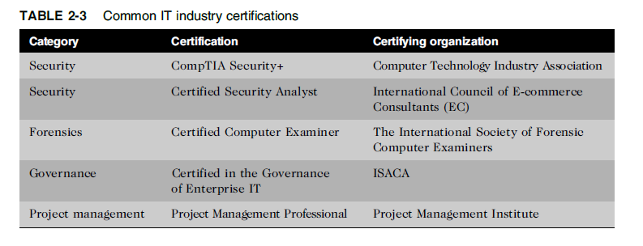
IT Certifications
Ethics in Information Technology, Third Edition

Slide 27
Certification (cont’d.)
Vendor certifications
Many IT vendors—such as Cisco, IBM, Microsoft, SAP, and Oracle—offer certification programs for those who use their products.
  Some certifications substantially improve IT workers’ salaries and career prospects
  Relevant for narrowly defined roles or certain aspects of broader roles
  Require passing a written exam
  Can take years to obtain experience
  Training can be expensive
  Workers are commonly recertified as newer technologies become available

Slide 28
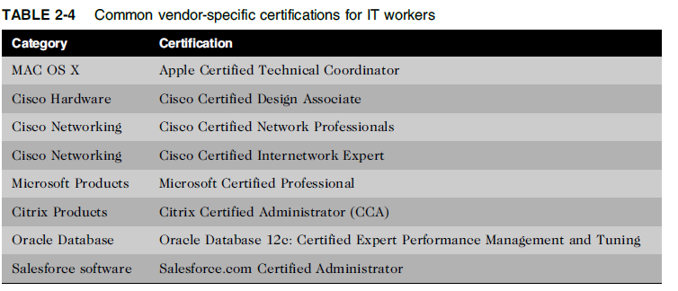
Ethics in Information Technology, Third Edition

Slide 29
Certification (cont’d.)
Industry association certifications
  Require a higher level of experience and a broader perspective than vendor certifications
  Lag in developing tests that cover new technologies
  Are moving from purely technical content to a broader mix of technical, business, and behavioral competencies
Ethics in Information Technology, Third Edition

Slide 30
Licensing of IT Professionals
Generally administered at the state level in the United States
Requires that recipient pass a test
Case for licensing IT workers
  Encourages following highest standards of profession
  Encourages practicing a code of ethics
  Violators would be punished
Without licensing, no requirements for heightened care and no concept of professional malpractice
Includes certified public accountants (CPAs), lawyers, doctors, various types of medical and daycare providers, and some engineers

Slide 31
Government Licensing (cont’d.)
Issues with government licensing of IT workers
  No universally accepted core body of knowledge
  Unclear who should manage content and administration of licensing exams
  No administrative body to accredit professional education programs
  No administrative body to assess and ensure competence of individual workers
Ethics in Information Technology, Third Edition

Slide 32
In 1993, the ACM and IEEE-CS formed a Joint Steering Committee for the Establishment of Software Engineering as a Profession
The initial recommendations of the committee were to define ethical standards, to define the required body of knowledge and recommended practices in software engineering, and to define appropriate curricula to acquire knowledge.
The core body of knowledge for any profession outlines agreed-upon sets of skills and abilities that all licensed professionals must possess
Ethics in Information Technology, Third Edition

Slide 33
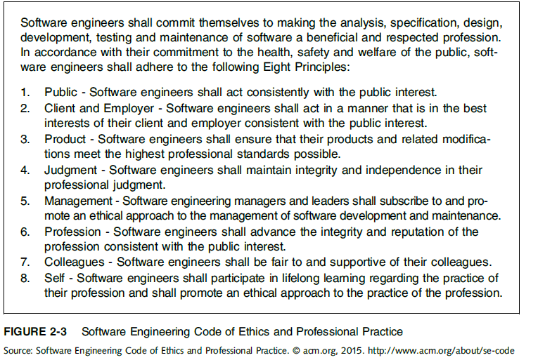
Software Engineering Code of Ethics and Professional Practice
Ethics in Information Technology, Third Edition

Slide 34
IT Professional Malpractice
Negligence: not doing something that a reasonable person would do, or doing something that a reasonable person would not do
Duty of care: obligation to protect people against any unreasonable harm or risk
  Reasonable person standard
  Reasonable professional standard
Professional malpractice: professionals who breach the duty of care are liable for injuries that their negligence causes
Ethics in Information Technology, Third Edition

Slide 35
IT Users
Employees’ ethical use of IT is an area of growing concern because of increased access to:
  Personal computers
  Corporate information systems and data
  The Internet
Ethics in Information Technology, Third Edition

Slide 36
Common Ethical Issues for IT Users
Software piracy
Inappropriate use of computing resources
  Reduces productivity and wastes time
  Could lead to lawsuits
Inappropriate sharing of information, including:
  Private data (employees and customers)
  Confidential information (company and operations)
Ethics in Information Technology, Third Edition

Slide 37
Supporting the Ethical Practices of
IT Users
Policies that protect against abuses:
  Set forth general rights and responsibilities of users
  Create boundaries of acceptable behavior
  Enable management to punish violators
Policy components include:
  Establishing guidelines for use of company software
  Defining and limiting appropriate use of IT resources
  Structuring information systems to protect data and information
  Installing and maintaining a corporate firewall
Ethics in Information Technology, Third Edition

Slide 38
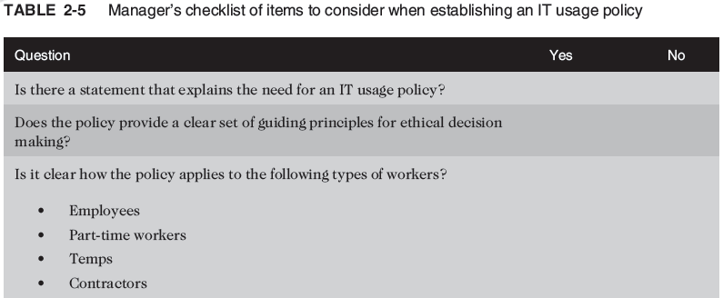
Supporting the Ethical Practices of
IT Users (cont’d.)
Ethics in Information Technology, Third Edition

Slide 39
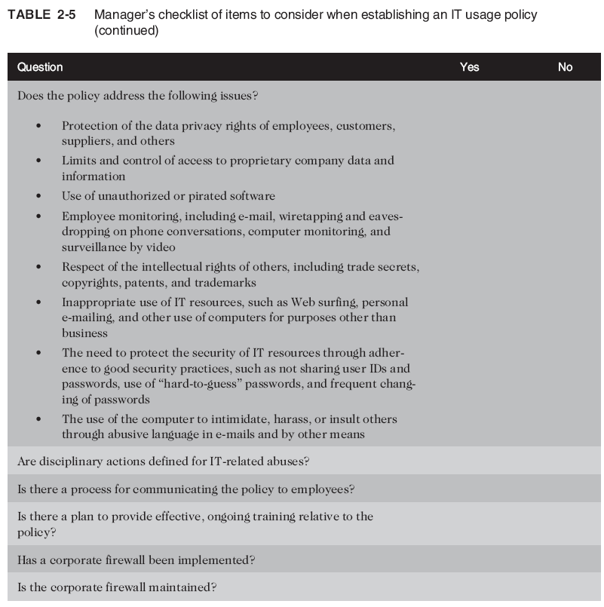
Ethics in Information Technology, Third Edition

Slide 40
Summary
Professionals
  Require advanced training and experience
  Must exercise discretion and judgment in their work
  Their work cannot be standardized
From a legal standpoint, a professional:
  Has passed the state licensing requirements
  Has earned the right to practice there
IT professionals have many different relationships
  Each with its own ethical issues and potential problems
Ethics in Information Technology, Third Edition

Slide 41
Summary (cont’d.)
Professional code of ethics
  States the principles and core values essential to the work of an occupational group
  Serves as a guideline for ethical decision making
  Promotes high standards of practice and behavior
  Enhances trust and respect from the general public
  Provides an evaluation benchmark
Licensing and certification of IT professionals
  Would increase the reliability and effectiveness of information systems
  Raises many issues
Ethics in Information Technology, Third Edition

Slide 42
Summary (cont’d.)
IT-related professional organizations have developed a code of ethics
These codes:
  Outline what the organization aspires to become
  List rules and principles for members
  Include a commitment to continuing education for those who practice the profession
Ethics in Information Technology, Third Edition

